Slide 1
Morphological Image Processing

Slide 2
Preview
Morphology “ – a branch in biology that deals with the form and structure of animals and plants.
Mathematical morphology is used to extract some properties of the image, useful for its presentation and descriptions. For example, contours, skeletons and convex hulls.

Slide 3
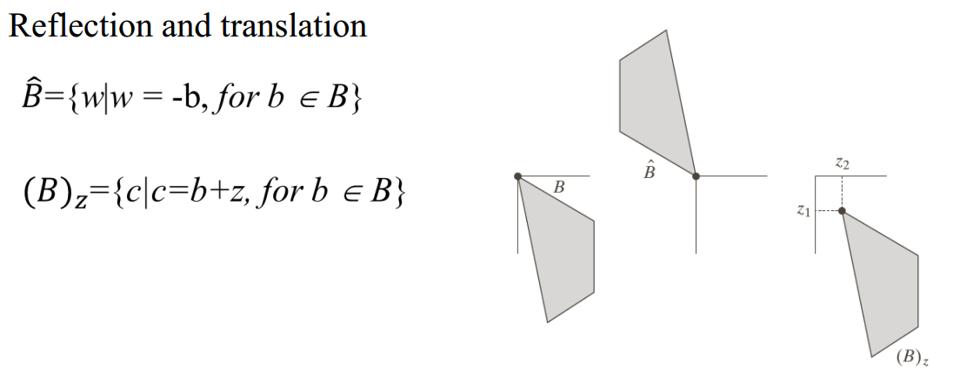
Preliminaries

Slide 4
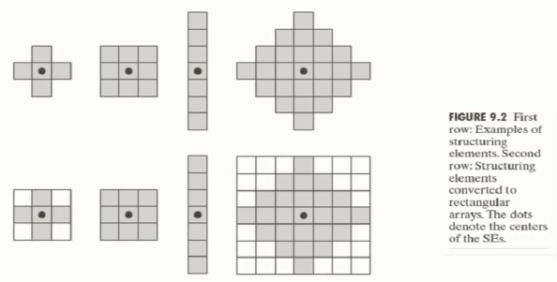
Structuring Elements
Morphological operations are defined based on structuring element.
A structuring element is a small sets or sub images used to probe an image under study.

Slide 5

Erosion
1 | 1 | 1 | 1 | 1 | 1
1 | 1 | 0 | 0 | 1 | 1
1 | 0 | 0 | 0 | 0 | 1
1 | 1 | 0 | 0 | 1 | 1
1 | 1 | 1 | 1 | 1 | 1
0 | 0 | 0 | 0 | 0 | 0
1 | 0 | 0 | 0 | 0 | 1
1 | 0 | 0 | 0 | 0 | 1
1 | 0 | 0 | 0 | 0 | 1
0 | 0 | 0 | 0 | 0 | 0
1
1
1

Slide 6
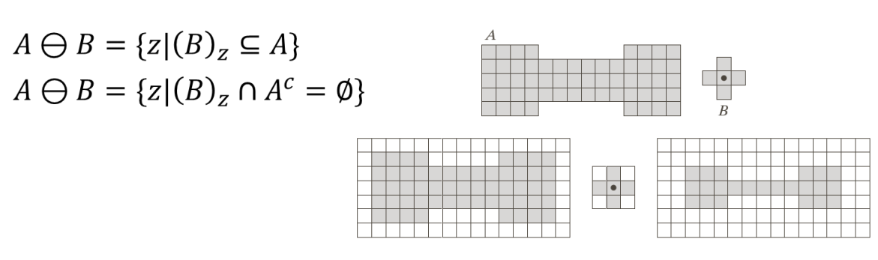
Erosion
Erosion is shrinking or thinning operation
The erosion of A by B is denoted by

Slide 7
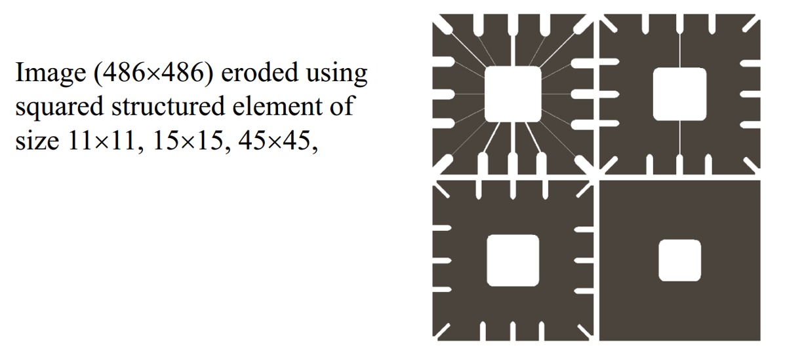
Erosion Example

Slide 8

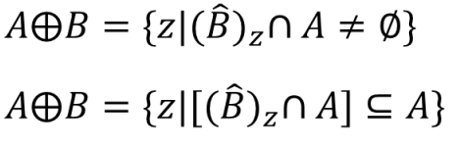
Dilation
Dilation grows or thickens object
The dilation of A and B is set of all displacement z, such that and A overlap by at least one element.

Slide 9
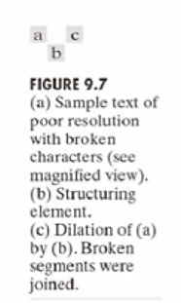
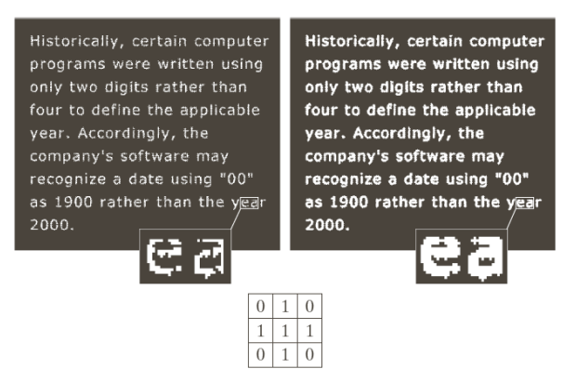
Dilation Example

Slide 10
Example of Dilation
Set B
0 | 0 | 0 | 0 | 0 | 0
0 | 0 | 1 | 1 | 0 | 0
0 | 0 | 0 | 0 | 1 | 0
0 | 0 | 1 | 1 | 0 | 0
0 | 1 | 0 | 0 | 1 | 0
0 | 0 | 0 | 0 | 0 | 0
0 | 0 | 0 | 0 | 0 | 0
0 | 0 | 1 | 1 | 1 | 0
0 | 0 | 0 | 0 | 1 | 1
0 | 0 | 1 | 1 | 1 | 0
0 | 1 | 1 | 0 | 1 | 1
0 | 0 | 0 | 0 | 0 | 0
1 | 1
1 | 1
Reflection of B
Set A
A B

Slide 11
Example of Dilation
Set B
0 | 0 | 0 | 0 | 0 | 0
0 | 0 | 1 | 1 | 0 | 0
0 | 0 | 0 | 0 | 1 | 0
0 | 0 | 1 | 1 | 0 | 0
0 | 1 | 0 | 0 | 1 | 0
0 | 0 | 0 | 0 | 0 | 0
0 | 0 | 0 | 0 | 0 | 0
0 | 0 | 1 | 1 | 1 | 0
0 | 0 | 0 | 0 | 1 | 1
0 | 0 | 1 | 1 | 1 | 0
0 | 1 | 1 | 0 | 1 | 1
0 | 0 | 0 | 0 | 0 | 0
1 | 1
1 | 1
Reflection of B
Set A
A B

Slide 12






Duality
Erosion and dilation are duals of each other with respect to set complementation and reflection.

Slide 13

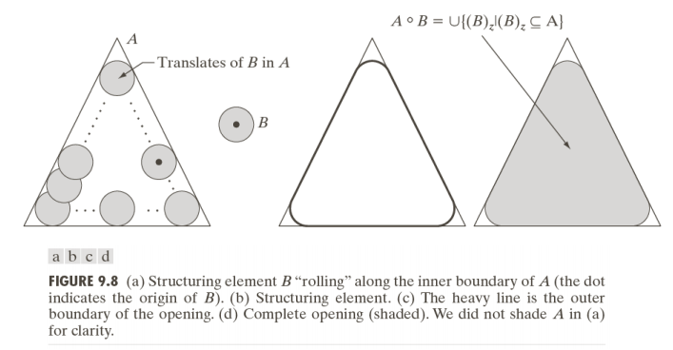

Opening
An erosion followed by dilation
the opening of A by B is obtained by taking the union of all translates of B that fit into A .

Slide 14

Closing
A dilation followed by erosion

Slide 15
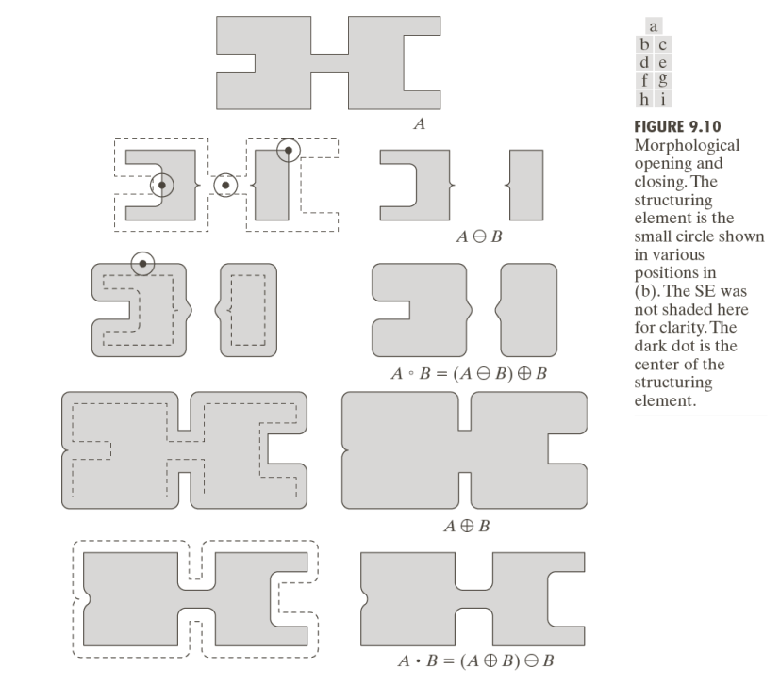

Slide 16
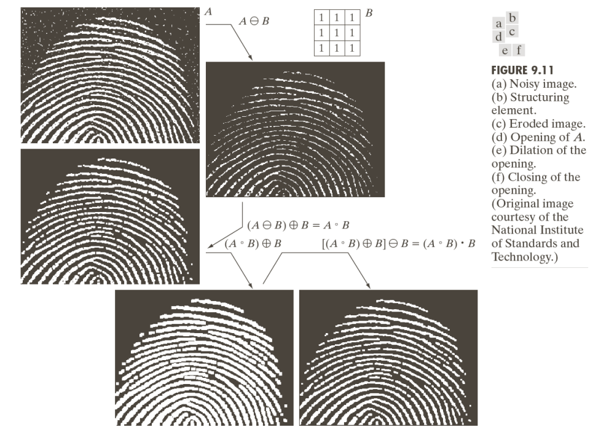

Slide 17

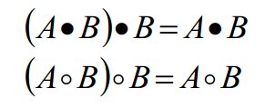
Opening and Closing
Opening and closing are duals of each others
A B is a subset or sub-image of A
A is a subset or sub-image of A B
Once an image been opened or closed, the re-application of same operation has no effect.

Slide 18
The Hit-or-Miss Transform
A basic tools to detect object with given shape and size

Slide 19
Hit-or-Miss Transformation
Set A
W
X
Structure element

Slide 20
Hit-or-Miss Transformation
Set A
A Ɵ X
W
X
W-X
Structure element

Slide 21
Hit-or-Miss Transformation
A complement
A^{C} Ɵ (W-X)
W-X

Slide 22
Hit-or-Miss Transformation
A Ɵ X
A^{C} Ɵ (W-X)
(A Ɵ X) ∩ (A^{C} Ɵ (W-X)) =?

Slide 23
Hit-or-Miss Transformation
Generalized equation
B = (B₁, B₂)
A B = (A Ɵ B₁ ) ∩ (A^{C} Ɵ B₂)
*

Slide 24
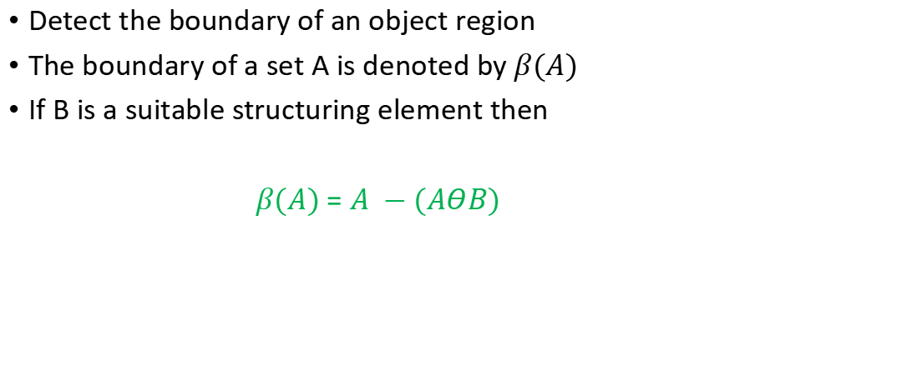
Boundary Extraction
Detect the boundary of an object region
The boundary of a set A is denoted by $β(A)$
If B is a suitable structuring element then
$β(A)$ = $A −(AΘB)$

Slide 25
Boundary Extraction
B
A

Slide 26
Boundary Extraction
B
A Ɵ B

Slide 27
Boundary Extraction
B
A - A Ɵ B
Boundary of an Object denoted by β(A) = A - A Ɵ B

Slide 28
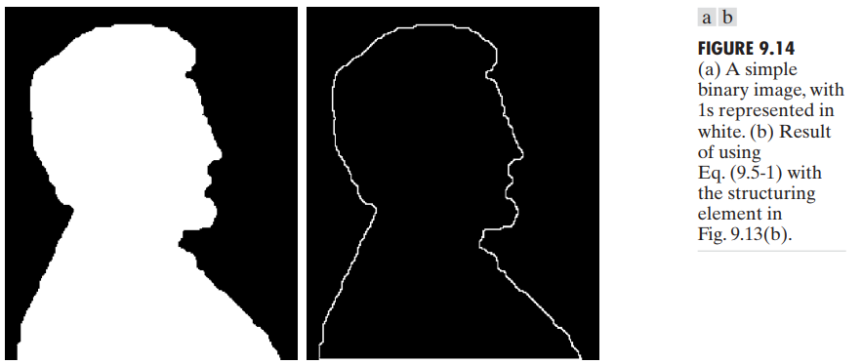
Boundary Extraction
1 | 1 | 1
1 | 1 | 1
1 | 1 | 1

Slide 29
Hole Filling
Fill up the hollow region within a boundary

Slide 30
Hole Filling
 | *
Set B
Set A

Slide 31
Hole Filling
 | *
Set B
It’s an iterative process
Let assume X₀ = P
X_{k} = (X_{k-1} B) ∩ A^{c}
Set A
We have a pixel named P

Slide 32
Hole Filling
 |  |  |  | 1
 |  |  | 1 | 1 | 1
 |  |  |  | 1
 | *
Set B
Iteration 1
X₀ = P = 1
X₁ = (X₀ B) ∩ A^{c}
X₀ B

Slide 33
Hole Filling
 | *
 |  |  |  | 1
 |  |  | 1 | 1 | 1
 |  |  |  | 1
X₁ = (X₀ B) ∩ A^{c} =?
Set A^{c}
X₀ B

Slide 34
Hole Filling
 |  |  |  | 1
 |  |  | 1 | 1
 |  |  |  | 1
 | *
Set B
Iteration 2
X₂ = (X₁ B) ∩ A^{c}
X₁ = (X₀ B) ∩ A^{c}

Slide 35
Hole Filling
 |  |  |  | 2
 |  |  | 2 | 1
 |  |  | 1 | 1
 |  |  | 2 | 1 | 2
 | *
Set B
Iteration 3
X₃ = (X₂ B) ∩ A^{c}
X₂ = (X₁ B) ∩ A^{c}

Slide 36
Hole Filling
 |  |  |  | 3
 |  |  | 3 | 2
 |  |  | 2 | 1
 |  |  | 1 | 1
 |  | 3 | 2 | 1 | 2
 | *
Set B
Iteration 4
X₄ = (X₃ B) ∩ A^{c}
X₃ = (X₂ B) ∩ A^{c}

Slide 37
Hole Filling
 |  |  |  | 4
 |  |  | 4 | 3
 |  |  | 3 | 2
 |  |  | 2 | 1
 |  |  | 1 | 1
 |  | 3 | 2 | 1 | 2
 | *
Set B
Iteration 5
X₅ = (X₄ B) ∩ A^{c}
X₄ = (X₃ B) ∩ A^{c}

Slide 38
Hole Filling
 |  |  |  | 5
 |  |  | 5 | 4
 |  |  | 4 | 3
 |  |  | 3 | 2
 |  |  | 2 | 1
 |  |  | 1 | 1
 |  | 3 | 2 | 1 | 2
 | *
Set B
Iteration 6
X₆ = (X₅ B) ∩ A^{c}
X₅ = (X₄ B) ∩ A^{c}

Slide 39
Hole Filling
 |  |  | 6 | 5
 |  | 6 | 5 | 4
 |  |  | 4 | 3
 |  |  | 3 | 2
 |  |  | 2 | 1
 |  |  | 1 | 1
 |  | 3 | 2 | 1 | 2
 | *
Set B
Iteration 7
X₇ = (X₆ B) ∩ A^{c}
X₆ = (X₅ B) ∩ A^{c}

Slide 40

Hole Filling
 |  |  | 6 | 5
 |  | 6 | 5 | 4
 |  |  | 4 | 3
 |  |  | 3 | 2
 |  |  | 2 | 1
 |  |  | 1 | 1
 |  | 3 | 2 | 1 | 2
 | *
Set B
Process terminate
X₇ = X₆
X_{k} = X_{k-1}
X₇ = (X₆ B) ∩ A^{c}
Final Set = ${ X}_{k}∪A$

Slide 41
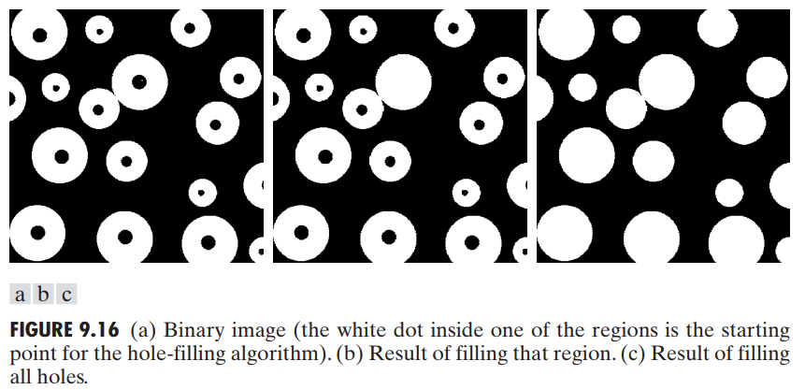
Hole Filling

Slide 42
Extraction of Connected Components
 | *
Set B
It’s an iterative process
Let assume X₀ = P
X_{k} = (X_{k-1} B) ∩ A
Set A
We have a pixel named P

Slide 43
Extraction of Connected Components
 |  |  | 1 | 1 | 1
 |  |  | 1 | 1 | 1
 |  |  | 1 | 1 | 1
 | *
Set B
Iteration 1
X₀ = P
X₁ = (X₀ B) ∩ A
X₀ B

Slide 44
Extraction of Connected Components
 |  |  | 1 | 1 | 1
 |  |  | 1 | 1 | 1
 |  |  | 1 | 1 | 1
X₁ = (X₀ B) ∩ A =?
X₀ B
Set A

Slide 45
Extraction of Connected Components
 |  |  | 1 | 1 | 1
 |  |  |  | 1
 | *
Set B
Iteration 2
X₂ = (X₁ B) ∩ A
X₁ = (X₀ B) ∩ A

Slide 46
Extraction of Connected Components
 |  |  |  |  |  | 2
 |  |  | 1 | 1 | 1 | 2
 |  | 2 |  | 1
 |  |  | 2
 | *
Set B
Iteration 3
X₃ = (X₂ B) ∩ A
X₂ = (X₁ B) ∩ A

Slide 47
Extraction of Connected Components
 |  |  |  |  |  | 3
 |  |  |  |  |  | 2 | 3
 |  |  | 1 | 1 | 1 | 2
 |  | 2 |  | 1
 |  |  | 2
 | *
Set B
Iteration 4
X₄ = (X₃ B) ∩ A
X₃ = (X₂ B) ∩ A

Slide 48
Extraction of Connected Components
 |  |  |  |  |  | 4
 |  |  |  |  |  | 3 |  | 4
 |  |  |  |  |  | 2 | 3 | 4
 |  |  | 1 | 1 | 1 | 2
 |  | 2 |  | 1
 |  |  | 2
 | *
Set B
Iteration 5
X₅ = (X₄ B) ∩ A
X₄ = (X₃ B) ∩ A

Slide 49
Extraction of Connected Components
 |  |  |  |  |  |  | 5
 |  |  |  |  |  | 4 |  | 5 | 5
 |  |  |  |  |  | 3 |  | 4 | 5
 |  |  |  |  |  | 2 | 3 | 4 | 5
 |  |  | 1 | 1 | 1 | 2
 |  | 2 |  | 1
 |  |  | 2
 | *
Set B
Iteration 6
X₆ = (X₅ B) ∩ A
X₅ = (X₄ B) ∩ A

Slide 50
Extraction of Connected Components
 |  |  |  |  |  |  | 5 | 6 | 6
 |  |  |  |  |  | 4 |  | 5 | 5
 |  |  |  |  |  | 3 |  | 4 | 5
 |  |  |  |  |  | 2 | 3 | 4 | 5
 |  |  | 1 | 1 | 1 | 2
 |  | 2 |  | 1
 |  |  | 2
 | *
Set B
Iteration 7
X₇ = (X₆ B) ∩ A
X₆ = (X₅ B) ∩ A

Slide 51
Extraction of Connected Components
 |  |  |  |  |  |  | 5 | 6 | 6
 |  |  |  |  |  | 4 |  | 5 | 5
 |  |  |  |  |  | 3 |  | 4 | 5
 |  |  |  |  |  | 2 | 3 | 4 | 5
 |  |  | 1 | 1 | 1 | 2
 |  | 2 |  | 1
 |  |  | 2
 | *
Set B
Process Terminate
X₇ = X₆
X₇ = (X₆ B) ∩ A

Slide 52
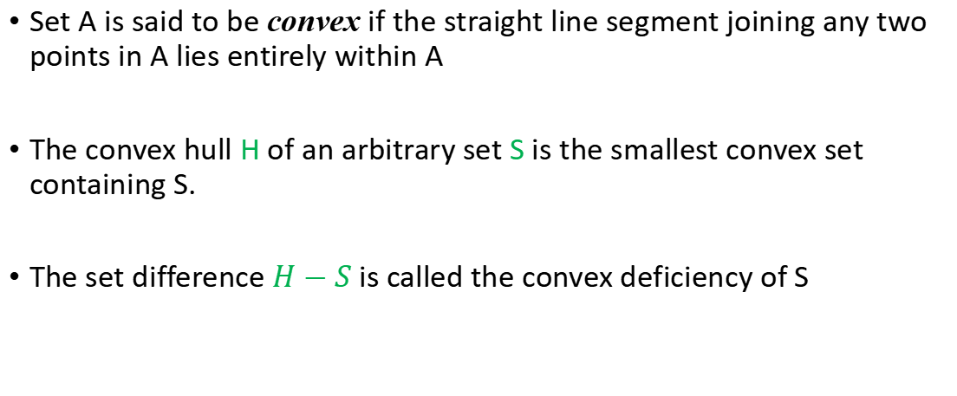
Convex Hull
Set A is said to be convex if the straight line segment joining any two points in A lies entirely within A
The convex hull H of an arbitrary set S is the smallest convex set containing S.
The set difference $H−S$is called the convex deficiency of S

Slide 53
Convex Hull
Convex set
Convex set S₁
Not Convex set S₂

Slide 54

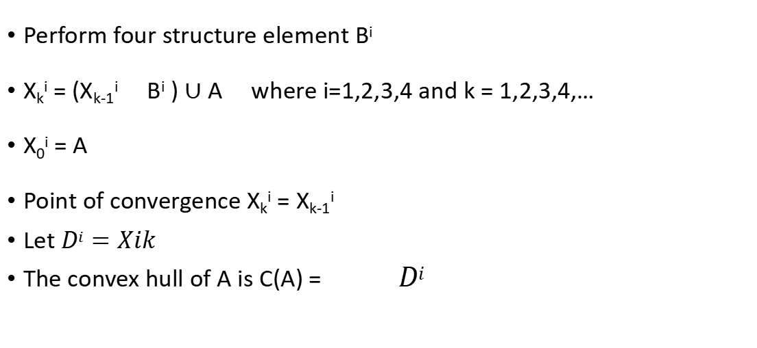
Perform four structure element B^{i}
X_{k}^{i} = (X_{k-1}^{i} B^{i} ) $∪$ A where i=1,2,3,4 and k = 1,2,3,4,…
X₀^{i} = A
Point of convergence X_{k}^{i} = X_{k-1}^{i}
Let $Di=Xik$
The convex hull of A is C(A) = $Di$

Slide 55
Convex Hull
B¹
B²
 | × | ×
 |  | ×
 | × | ×
× |  | ×
× | × | ×
B³
B⁴
× | ×
×
× | ×
× | × | ×
× |  | ×
^{Set A}

Slide 56
Convex Hull
B¹
 | × | ×
 |  | ×
 | × | ×
 |  |  |  |  |  | 1
 |  |  |  |  |  | 1
 |  |  |  |  |  | 1
 |  |  |  |  |  |  | 1
Iteration 1
X₁¹

Slide 57
Convex Hull
B¹
 | × | ×
 |  | ×
 | × | ×
 |  |  |  |  |  | 1
 |  |  |  |  |  | 1
 |  |  |  |  |  | 1
 |  |  |  |  |  |  | 1
Iteration 1
X₁¹

Slide 58
Convex Hull
B¹
 | × | ×
 |  | ×
 | × | ×
 |  |  |  |  |  | 1 | 2
 |  |  |  |  |  | 1
 |  |  |  |  |  | 1
 |  |  |  |  |  |  | 2
 |  |  |  |  |  |  | 1
Iteration 2
X₂¹

Slide 59
Convex Hull
B¹
 | × | ×
 |  | ×
 | × | ×
 |  |  |  |  |  | 1 | 2
 |  |  |  |  |  | 1 |  | 3
 |  |  |  |  |  | 1 |  | 3
 |  |  |  |  |  |  | 2 | 3
 |  |  |  |  |  |  | 1
Iteration 3
X₃¹

Slide 60
Convex Hull
B¹
 | × | ×
 |  | ×
 | × | ×
 |  |  |  |  |  | 1 | 2
 |  |  |  |  |  | 1 |  | 3
 |  |  |  |  |  | 1 |  | 3 | 4
 |  |  |  |  |  |  | 2 | 3
 |  |  |  |  |  |  | 1
Iteration 4
X₄¹

Slide 61
Convex Hull
B¹
 | × | ×
 |  | ×
 | × | ×
 |  |  |  |  |  | 1 | 2
 |  |  |  |  |  | 1 |  | 3
 |  |  |  |  |  | 1 |  | 3 | 4
 |  |  |  |  |  |  | 2 | 3
 |  |  |  |  |  |  | 1
Iteration 5
X₅¹ =X₄¹
Process terminate

Slide 62
Convex Hull
B²
× |  | ×
× | × | ×
 |  |  |  |  |  | 1 | 2
 |  |  | 1 |  |  | 1 |  | 3
 |  |  |  |  |  | 1 |  | 3 | 4
 |  |  |  |  |  |  | 2 | 3
 |  |  |  |  | 1 |  | 1
Iteration 1
X₁²

Slide 63
Convex Hull
B²
× |  | ×
× | × | ×
 |  |  |  |  |  | 1 | 2
 |  |  | 1 |  |  | 1 |  | 3
 |  |  |  |  |  | 1 |  | 3 | 4
 |  |  |  |  |  |  | 2 | 3
 |  |  |  |  | 1 |  | 1
Iteration 2
X₂² =X₁²
Process terminate

Slide 64
Convex Hull
B³
× | ×
×
× | ×
 |  |  |  |  |  | 1 | 2
 |  |  | 1 |  |  | 1 |  | 3
 |  |  | 1 |  |  | 1 |  | 3 | 4
 |  |  |  |  |  |  | 2 | 3
 |  |  |  | 1 | 1 |  | 1
 |  |  |  | 1
Iteration 1
X₁³

Slide 65
Convex Hull
B³
× | ×
×
× | ×
 |  |  |  |  |  | 1 | 2
 |  | 2 | 1 |  |  | 1 |  | 3
 |  |  | 1 |  |  | 1 |  | 3 | 4
 |  |  | 2 |  |  |  | 2 | 3
 |  |  | 2 | 1 | 1 |  | 1
 |  |  |  | 1
Iteration 2
X₂³

Slide 66
Convex Hull
B³
× | ×
×
× | ×
 | 3 |  |  |  |  | 1 | 2
 |  | 2 | 1 |  |  | 1 |  | 3
 |  | 3 | 1 |  |  | 1 |  | 3 | 4
 |  | 3 | 2 |  |  |  | 2 | 3
 |  |  | 2 | 1 | 1 |  | 1
 |  |  |  | 1
Iteration 3
X₃³

Slide 67
Convex Hull
B³
× | ×
×
× | ×
 | 3 |  |  |  |  | 1 | 2
 | 4 | 2 | 1 |  |  | 1 |  | 3
 | 4 | 3 | 1 |  |  | 1 |  | 3 | 4
 |  | 3 | 2 |  |  |  | 2 | 3
 |  |  | 2 | 1 | 1 |  | 1
 |  |  |  | 1
Iteration 4
X₄³

Slide 68
Convex Hull
B³
× | ×
×
× | ×
 | 3 |  |  |  |  | 1 | 2
5 | 4 | 2 | 1 |  |  | 1 |  | 3
 | 4 | 3 | 1 |  |  | 1 |  | 3 | 4
 |  | 3 | 2 |  |  |  | 2 | 3
 |  |  | 2 | 1 | 1 |  | 1
 |  |  |  | 1
Iteration 5
X₅³

Slide 69
Convex Hull
B³
× | ×
×
× | ×
 | 3 |  |  |  |  | 1 | 2
5 | 4 | 2 | 1 |  |  | 1 |  | 3
 | 4 | 3 | 1 |  |  | 1 |  | 3 | 4
 |  | 3 | 2 |  |  |  | 2 | 3
 |  |  | 2 | 1 | 1 |  | 1
 |  |  |  | 1
Iteration 6
X₆³ =X₅³
Process terminate

Slide 70
Convex Hull
B⁴
× | × | ×
× |  | ×
 |  |  |  | 1
 | 3 |  |  |  |  | 1 | 2
5 | 4 | 2 | 1 |  |  | 1 |  | 3
 | 4 | 3 | 1 |  |  | 1 |  | 3 | 4
 |  | 3 | 2 |  |  |  | 2 | 3
 |  |  | 2 | 1 | 1 |  | 1
 |  |  |  | 1
Iteration 1
X₁⁴

Slide 71
Convex Hull
B⁴
× | × | ×
× |  | ×
 |  |  |  | 1
 | 3 |  |  |  |  | 1 | 2
5 | 4 | 2 | 1 |  |  | 1 |  | 3
 | 4 | 3 | 1 |  |  | 1 |  | 3 | 4
 |  | 3 | 2 |  |  |  | 2 | 3
 |  |  | 2 | 1 | 1 |  | 1
 |  |  |  | 1
Iteration 2
X₂⁴ =X₁⁴
Process terminate

Slide 72
Convex Hull
So the convex hull is
 |  |  |  | 1
 | 3 |  |  |  |  | 1 | 2
5 | 4 | 2 | 1 |  |  | 1 |  | 3
 | 4 | 3 | 1 |  |  | 1 |  | 3 | 4
 |  | 3 | 2 |  |  |  | 2 | 3
 |  |  | 2 | 1 | 1 |  | 1
 |  |  |  | 1

Slide 73
Convex Hull drawbacks
Convex hull is the minimal of convex set
 |  |  |  | 1
 | 3 |  |  |  |  | 1 | 2
5 | 4 | 2 | 1 |  |  | 1 |  | 3
 | 4 | 3 | 1 |  |  | 1 |  | 3 | 4
 |  | 3 | 2 |  |  |  | 2 | 3
 |  |  | 2 | 1 | 1 |  | 1
 |  |  |  | 1
 |  |  |  |  |  | 1 | 2
 |  | 2 | 1 |  |  | 1
 |  | 3 | 1 |  |  | 1
 |  | 3 | 2 |  |  |  | 2
 |  |  | 2 | 1 | 1 |  | 1
 |  |  |  | 1

Slide 74
Convex Hull drawbacks solution
Limit horizontal, vertical and diagonal dimension
 |  |  |  | 1
 | 3 |  |  |  |  | 1 | 2
5 | 4 | 2 | 1 |  |  | 1 |  | 3
 | 4 | 3 | 1 |  |  | 1 |  | 3 | 4
 |  | 3 | 2 |  |  |  | 2 | 3
 |  |  | 2 | 1 | 1 |  | 1
 |  |  |  | 1
 |  |  |  |  |  | 1 | 2
 |  | 2 | 1 |  |  | 1
 |  | 3 | 1 |  |  | 1
 |  | 3 | 2 |  |  |  | 2
 |  |  | 2 | 1 | 1 |  | 1
 |  |  |  | 1

Slide 75



Thinning
The thinning of set A by a structuring element B
$A ⊗B=A −(A$ B)
A sequence of structuring element
Every B^{i} is the rotated version of B^{i-1}
Thinning is defined by

Slide 76
Thinning
× | * | ×
B¹
B²
B³
B⁴
B⁵
B⁶
B⁷
B⁸
Set A

Slide 77
Thinning
× | * | ×
B¹
×
 | *
 |  | ×
B²

Slide 78
Thinning
 | ×
 | *
 | ×
B³
 |  | ×
 | *
×
B⁴

Slide 79
Thinning
× | * | ×
B⁵
×
 | *
 |  | ×
B⁶

Slide 80
Thinning
 | ×
 | *
 | ×
B⁷
A₈ = A₇ B⁷
 |  | ×
 | *
×
B⁸
A₉ = A₈ B⁸

Slide 81
Thinning
× | * | ×
B¹
A₁₀ = A₉ B¹
×
 | *
 |  | ×
B²
A₁₁ = A₁₀ B²

Slide 82
Thinning
 | ×
 | *
 | ×
B³
A₁₂ = A₁₁ B³
 |  | ×
 | *
×
B⁴
A₁₃ = A₁₂ B⁴

Slide 83
Thinning
× | * | ×
B⁵
A₁₄ = A₁₃ B⁵
No more change
converted to m-connectivity

Slide 84


Thickening
Dual of Thinning
Operation A=> A^{c}
Calculate thinning of A^{c}
Then again calculate the complement of Thinning of A^{c}

Slide 85
Thickening
A^{c}
Set A
Thinning of A^{c}
Complement of thinning A^{c}

Slide 86
Thickening
Thickening
final result with no disconnected points

Slide 87
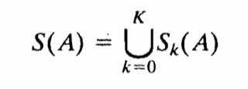


Skeletons
The skeleton of A can be expressed in term of erosion and openings

Slide 88
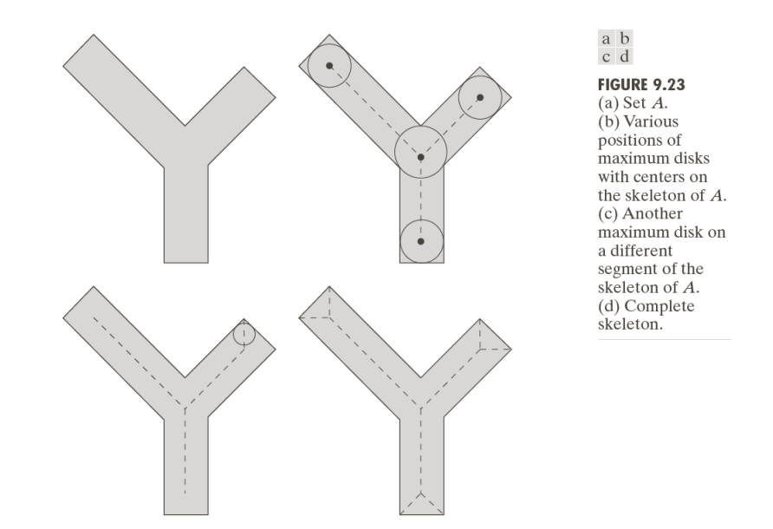
Skeletons

Slide 89
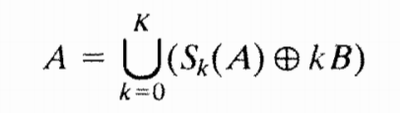
Skeletons
Using skeleton we can retrieved original points set

Slide 90



k=0
B

Slide 91
k=1

Slide 92
k=2

Slide 93

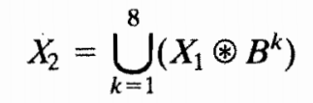


Pruning
Removing parasitic component
Essential Complement to thinning and skeletonizing

Slide 94
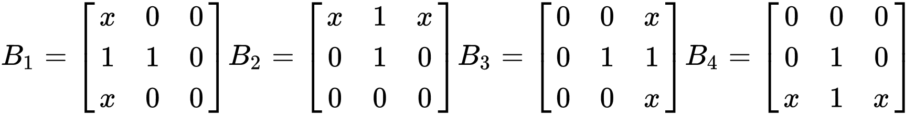
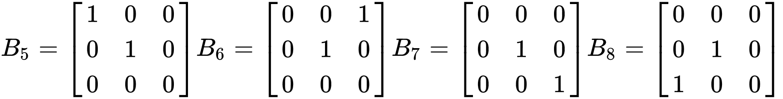
Structuring Elements
‘x’ indicates a “don’t care” condition

Slide 95

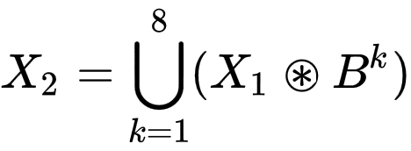
Step 1: Thinning
Apply this step a given (n) times to eliminate any branch with (n) or less pixels.
Step 2: Find End Points
Wherever the structuring elements are satisfied, the center of the 3x3 matrix is considered an endpoint.

Slide 96


Step 3: Dilate End Points
Perform dilation using a 3x3 matrix (H) consisting of all 1's and only insert 1's where the original image (A) also had a 1. Perform this for each endpoint in all direction (n) times.
Step 4: Union of X1 & X3
Take the result from step 1 and union it with step 3 to achieve the final results.

Slide 97
Gray scale Image
In gray scale images on the contrary to binary images we deal with digital image functions of the form
f(x,y) as an input image and
b(x,y) as a structuring element.
(x,y) represents a coordinates in the image.

Slide 98
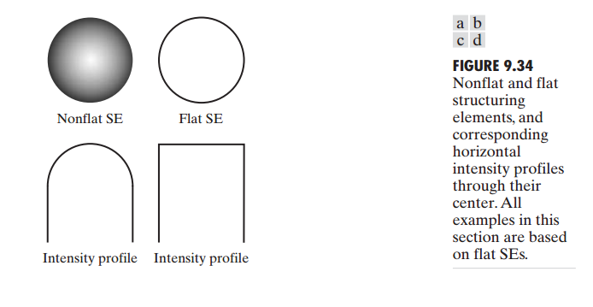
Structuring elements
Structuring elements in gray-scale morphology belong to one of two categories: nonflat and flat.

Slide 99
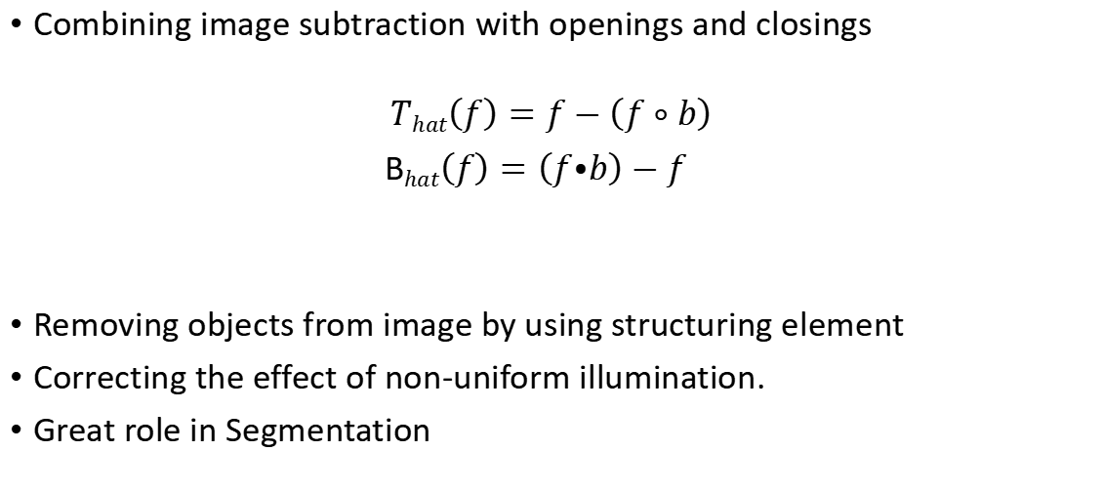
Top-hat and bottom-hat transformations
Combining image subtraction with openings and closings
$$That\left(f\right)=f−\left(f∘b\right)$$
B$hat\left(f\right)=\left(f⦁b\right)−f$
Removing objects from image by using structuring element
Correcting the effect of non-uniform illumination.
Great role in Segmentation

Slide 100
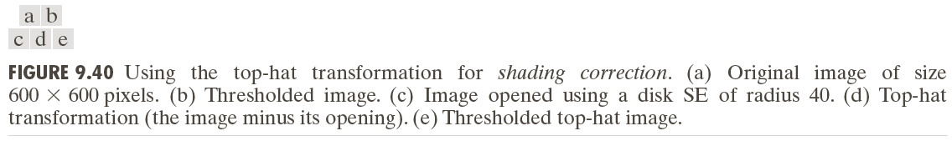
Top-hat and bottom-hat transformations

Slide 101
Textural segmentation
The objectives is to find a boundary between two regions based on their textural content.
Using closings and openings

Slide 102
Textural segmentation

Slide 103
References
Digital Image Processing 3rd edition, Rafael C. Gonzalez, Richard E. Woods
http://inside.mines.edu/~whoff/courses/EENG510/
https://en.wikipedia.org/wiki/Pruning_(morphology)
Special Thanks to Md. Shamimur Rahman

